Slide 1

SECTION 2
Static Games of Complete Information
TOPIC 1
The Normal-Form Representation
MODULES
Introducing Games
Static Games of Complete Information
A Pure Strategy
The Normal-Form Game
Canonical Games…
Class 12
Strategy spaces
Discrete
Continuous
Finite?
Matrix-representation?

Slide 2

Logistics
Exams and Grading Scheme
Exam 2
April
24
Friday
2:30 – 4 PM
Focus
Problem-solving
Exam 1
February
27
Friday
2:30 – 4 PM
35%
Venue
LHC-06
25%
Test 1
February
3
Tuesday
4 – 5:30 PM
Test 2
March
27
Friday
2:30 – 4 PM
Focus
Conceptual understanding
Attendance
15%
15%
10%

Slide 3

Cournot Duopoly
A strategic interaction between two firms in which each firm attempts to maximize its profit
Economic Models of Competition
Coffee wars: Duopoly with discrete strategy spaces
Continuous Strategy Spaces
Static game of complete information
Normal-form representation

Slide 4










The Scenario
Static
Rigid
$$q⇒p$$
Production Costs
Depend on quantity produced
Demand curve
EXAMPLE
Price
Based on supply (total quantity produced by both firms)
Same for both firms
Profits
Strategic interaction
Production Costs
Price
$$c_{i}\left(q_{i}\right)={cq}_{i}^{2}$$
$$p=a−b\left(q_{1}+q_{2}\right)$$
Quantities
Independently & simultaneously
Upfront
$$q_{1}$$
Firm 1
Decision
How much of the good to produce?
Duopoly
Good
Compete
Homogeneous
$$q_{2}$$
Maximize profits
A Market
Monopoly → Duopoly
$$Profit = Sales Revenue – Production Costs$$
Uniform pricing: A single price applies to all buyers, regardless of differences in their willingness to pay
Firm 2

Slide 5

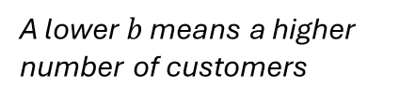




Visualizing Sales Revenue
The “Flipped” Demand Curve
$$p=a−b\left(q_{1}+q_{2}\right)$$
Quantity-intercept: Saturated market
$$q=\left(q_{1}+q_{2}\right)=\frac{a}{b}−\frac{1}{b}p$$
Area = (Price X Quantity) = Sales Revenue
$$q=a/b$$
Monopoly
Single-Person Decision Problem
Determine the quantity-price rectangle with the largest area = maximize profits
$$q=\frac{a}{b}−\frac{1}{b}p$$
Quantity
A lower $b$ means a higher number of customers
Sales Revenue 2
Strategic interaction
Price
$$p=a$$
Sales Revenue 1
Maximum willingness to pay

Slide 6



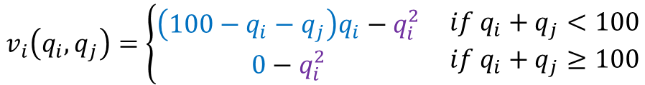




The Normal-Form Representation
Customers buy from firms in proportion to their output.
$$s_{i}$$
Players
$$N=\left\{1, 2\right\}$$
Strategy sets
$$S_{i}=\left[0, ∞\right]$$
for
$$i∈\left\{1, 2\right\}$$
Firms choose quantities $q_{i}∈S_{i}$
Solution
Set of Payoffs
$$v_{i}\left(q_{i}, q_{j}\right)=\left\{\begin{aligned}\left(100−q_{i}−q_{j}\right)q_{i}−q_{i}^{2} \\ 0−q_{i}^{2}\end{aligned}\right. \begin{matrix}if q_{i}+q_{j}<100 \\ if q_{i}+q_{j}≥100\end{matrix}$$
…function of strategy profiles
Decision
How much of the good to produce?
Saturated market
Quantity produced
$$Profit = Sales Revenue – Production Costs$$
Price
Production Costs
$$p=100−\left(q_{1}+q_{2}\right)$$
$$c_{i}\left(q_{i}\right)=q_{i}^{2}$$
Determined by demand

Slide 7



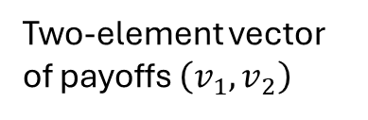
The Matrix Representation
Player 2
…not a finite game
Elements of $S_{2}$
Player 1
Elements of $S_{1}$
Two-element vector of payoffs $\left(v_{1},v_{2}\right)$

Slide 8
Bertrand Duopoly
A strategic interaction between two firms in which each firm attempts to maximize its profit
Economic Models of Competition
Continuous Strategy Spaces
Static game of complete information
Normal-form representation

Slide 9


The Scenario
Dynamic
Flexible
Production Costs
Depend on quantity produced
EXAMPLE
Price
Set by each firm independently
Different for each firm
Profits
Strategic interaction
Production Costs
Prices:
$$p_{1}, p_{2}$$
$$c_{i}\left(q_{i}\right)=cq_{i}^{2}$$
Market demand
Independently & simultaneously
Real time
Quantities
$$q_{1}$$
Firm 1
Decision
What price to set for the good?
Duopoly
Good
Compete
Homogeneous
$$q_{2}$$
Maximize profits
A Market
Firm 2
$$Profit = Sales Revenue – Production Costs$$

Slide 10


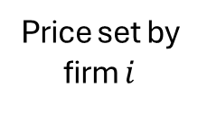



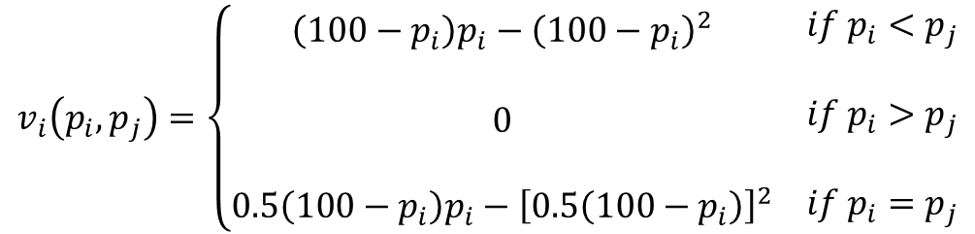
The Normal-Form Representation
Customers buy from the firm with the lower price.
$$Profit = Sales Revenue – Production Costs$$
Players
$$N=\left\{1, 2\right\}$$
Strategy sets
$$S_{i}=\left[0, ∞\right]$$
for
$$i∈\left\{1, 2\right\}$$
Firms set price $p_{i}∈S_{i}$
Price set by firm $i$
$$q_{i}\left(p_{i}, p_{j}\right)=\left\{\begin{aligned}100−p_{i} \\ \\ 0 \\ \\ 0.5\left(100−p_{i}\right)\end{aligned} \begin{matrix}\begin{aligned}if p_{i}<p_{j} \\ \end{aligned} \\ \begin{aligned}if p_{i}>p_{j} \\ \end{aligned} \\ if p_{i}=p_{j}\end{matrix}\right.$$
Quantities
Decision
What price to set for the good?
…determined by the market based on the prices set by the two firms relative to each other
…on the fly
$$v_{i}\left(p_{i}, p_{j}\right)=\left\{\begin{aligned}\left(100−p_{i}\right)p_{i}−{\left(100−p_{i}\right)}^{2} \\ \\ 0 \\ \\ 0.5\left(100−p_{i}\right)p_{i}−{\left[0.5\left(100−p_{i}\right)\right]}^{2}\end{aligned} \begin{matrix}\begin{aligned}if p_{i}<p_{j} \\ \end{aligned} \\ \begin{aligned}if p_{i}>p_{j} \\ \end{aligned} \\ if p_{i}=p_{j}\end{matrix}\right.$$
Set of Payoffs

